Slide 1

Real time rotation scaling invariant Hasta Mudra classification using deep learning framework
Department of Computer Science and Engineering INDIAN INSTITUTE OF TECHNOLOGY KHARAGPUR
M.Tech Seminar – II
Supervisor
Dr. Partha Pratim Das
Presented By
Gautam Sagar
21CS60R15
05/04/2022

Slide 2
Outline of Presentation
Introduction
Hand Gesture Recognition(HGR)
Methods for Vision Based HGR
Vision Based HGR using ML
Vision Based HGR using DL
Conclusion

Slide 3
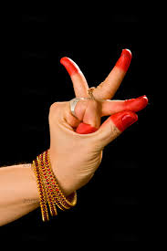
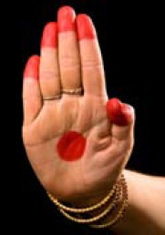
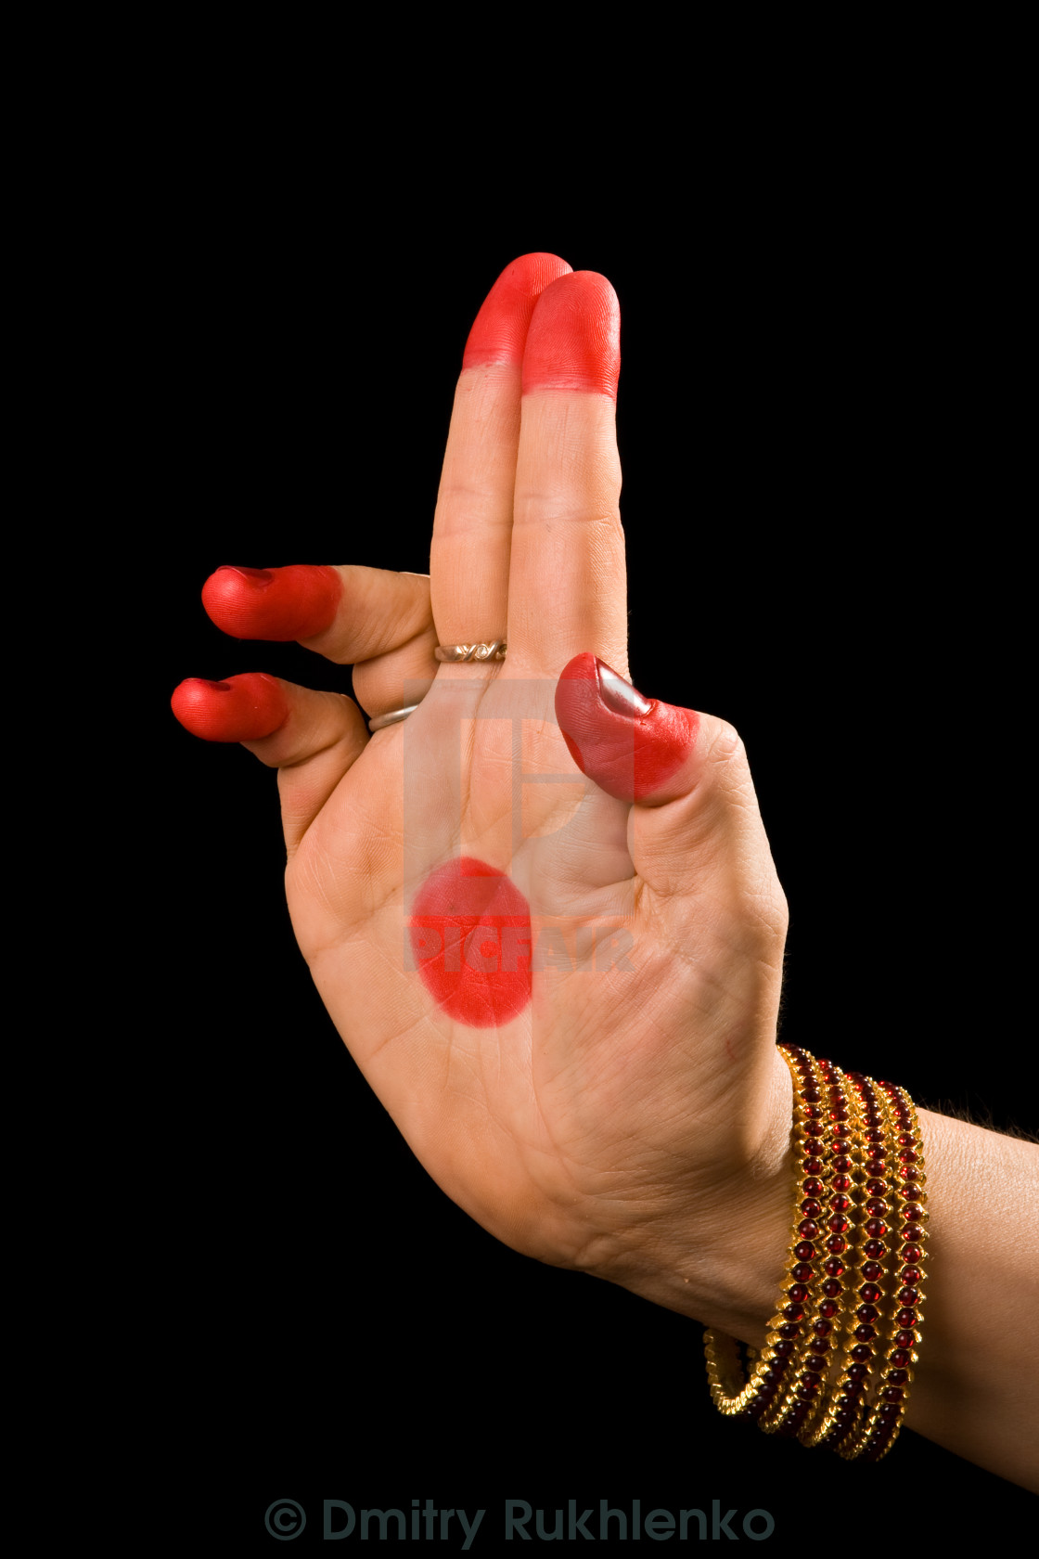
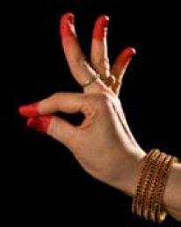
INTRODUCTION
Several Indian classical dance forms use mudras(hand gestures) to communicate the story line.
Bharatnatyam has total 52 hand gestures.
28 Single hand gestures (asamyukta hastas)
24 double hand gestures (samyukta hastas)
Challenges in mudras classification
Low Illumination
Recording from different camera angles
Distance between camera and the performer
Desirable characteristics of Mudra classification system:
Fast
Illumination Invariant
Rotation Invariant
Scaling Invariant

Slide 4
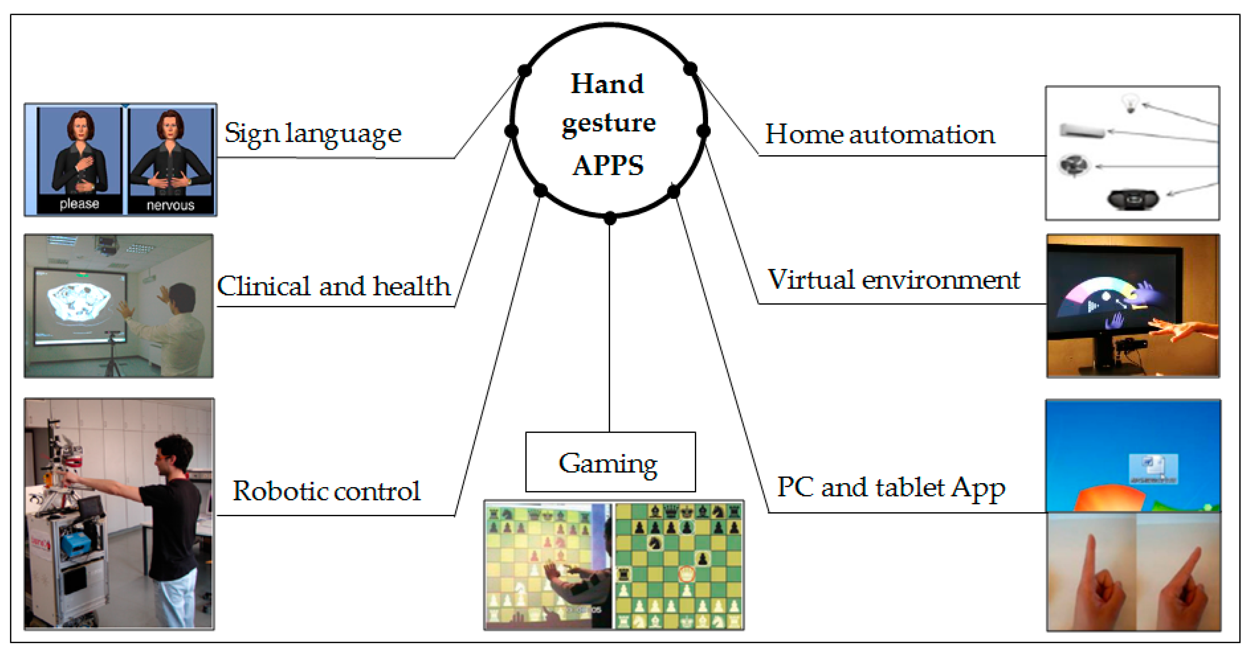
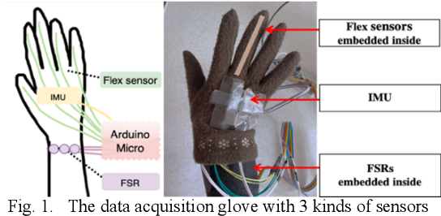
HAND GESTURE RECOGNITION(HGR)
HGR is an important domain of computer vision research, with applications in Human/Computer interfaces (HCI).
Two methods:
Glove Based
Vision Based

Slide 5
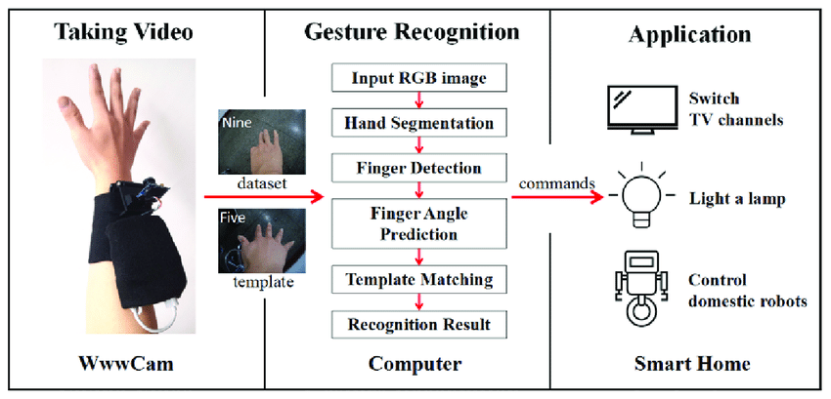

Slide 6
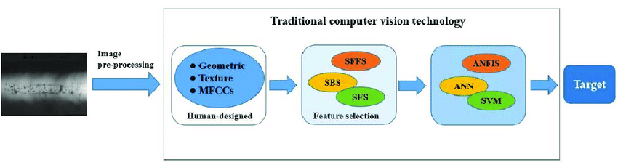
Methods for Vision Based HGR
Traditional methods were mostly based on:
colour recognition
appearance recognition.
Problems with traditional methods:
Variation of illumination
Rotation
Background
Scaling
Translation
Performance improved using ML methods

Slide 7
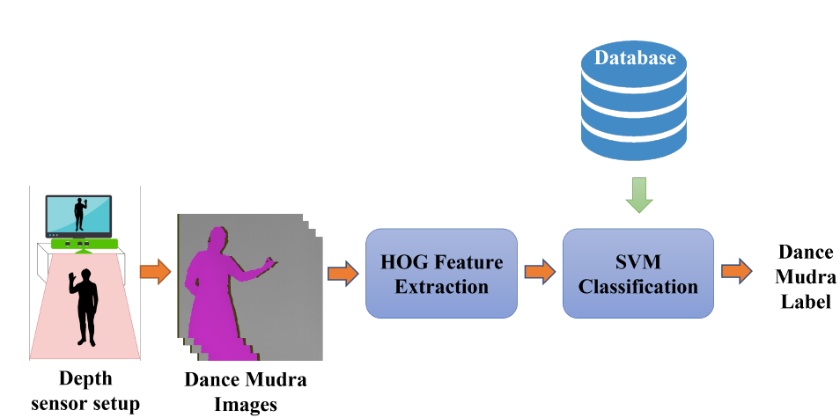
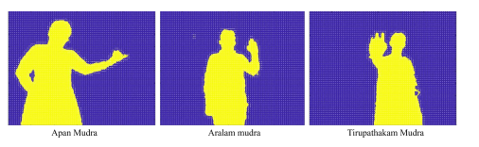
Vision Based HGR using ML
Features used:
HOG
SURF
SIFT
HAAR
LBP
Classifiers:
SVM
KNN
Problems with ML based methods:
Require hand crafted features
Can suffer with previous limitations

Slide 8
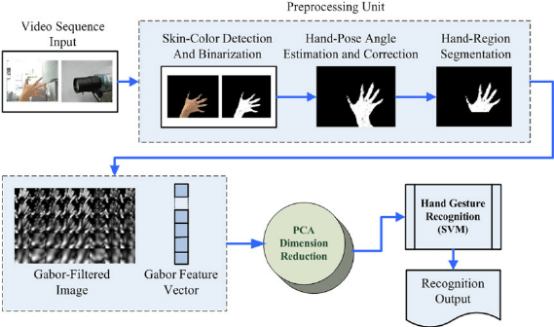

Slide 9
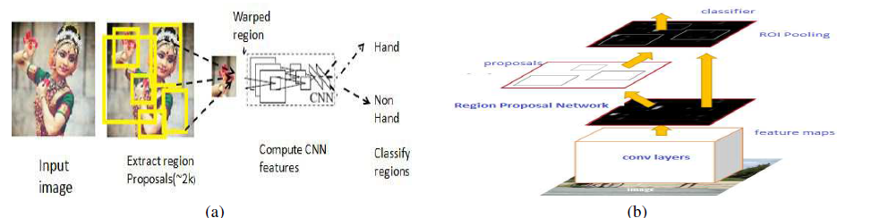
Vision Based HGR using DL
Convolutional neural network (CNN) are known to be Scaling, rotation and translation invariant.
Robust to complex background and low illumination.
Suitable for real time application
(a) RCNN architecture
(b) Faster R-CNN architecture

Slide 10
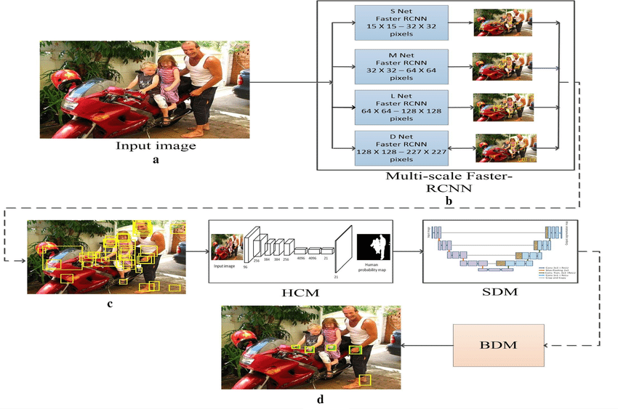
(a) Input Image (b) Multi-scale Faster-RCNN stage consisting of four Faster-RCNNs with different architectures. (c) Detected bounding boxes obtained from each Faster-RCNN overlaid on top of input image (d) Final hand detection results after post-processing with HCM, human context module; SDM, skin detection module; BDM, blob detection module

Slide 11
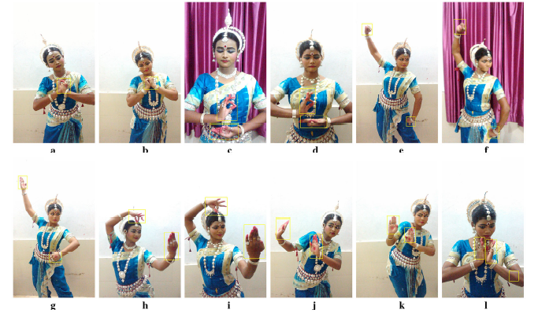
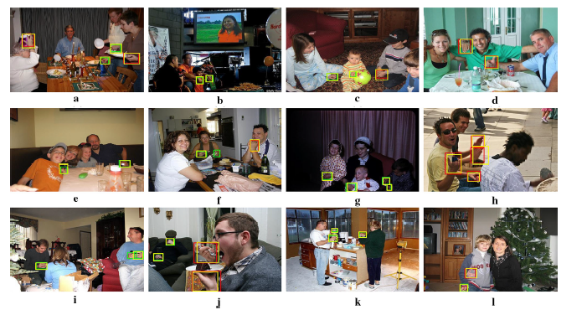
Results
Some examples of experimental evaluation on ICD hand dataset. It can be noted that despite background clutter the model can detect hands robustly
Examples of experimental evaluation on Oxford hand. Yellow boxes indicate detected results. Red boxes indicate large hand instances (> 1500 sq. pixel), and green boxes indicate small hand instances

Slide 12
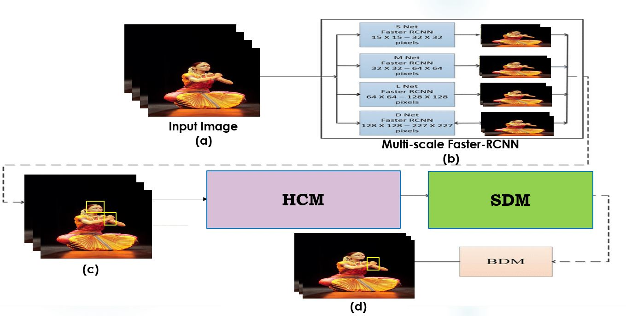
MTP
Real time rotation scaling invariant Hasta Mudra classification using deep learning framework

Slide 13
Conclusion
Traditional methods for HGR are not robust to changing environment
ML based methods require domain expert for hand crafting features
CNN based methods are robust to changing conditions, thus they can be good choice for the desirable gesture recognition system.
Real Time Mudra recognition requires robust system invariant to illumination, rotation, scaling and translation

Slide 14
References
D. Arpitha, M. Balasubrahmanyam and D. A. Kumar, "Depth based Indian Classical Dance Mudra's Recognition using Support Vector Machine," 2022 4th International Conference on Smart Systems and Inventive Technology (ICSSIT), 2022, pp. 885-888, doi: 10.1109/ICSSIT53264.2022.9716486.
K. Roy, A. Mohanty and R. R. Sahay, "Deep Learning Based Hand Detection in Cluttered Environment Using Skin Segmentation," 2017 IEEE International Conference on Computer Vision Workshops (ICCVW), 2017, pp. 640-649, doi: 10.1109/ICCVW.2017.81.
K. Roy and R. R. Sahay, “A robust multi-scale deep learning approach for unconstrained hand detection aided by skin segmentation,” The Visual Computer, 2021, pp. 1-25, doi: 10.1007/s00371-021-02157-8

Slide 15
THANK YOU

